Slide 1
2014 - 2015
District of Columbia
Snow Removal
Program
Mayor Vincent C. Gray
DPW Director William O. Howland , Jr.

Slide 2
Agenda
Mission/Scope
Deployment Process
Monitoring/Tracking
Weather Statistics
Snow And Ice Resources
Improvements/Lessons Learned
Challenges/Concerns
Snow Fleet
Snow Budget
Salt Dome

Slide 3
Mission
Our mission is to keep our primary, secondary and residential roads safe for vehicular traffic, provide for safe pedestrian mobility on District bridges and around District public buildings, expedite the return of normal traffic flow, and resume normal government service delivery and business commerce in an efficient and safe manner.
The following agencies partner with DPW and DDOT to support the District Snow Team: DGS; OUC; DC Water; DOC; HSEMA; MPD; FEMS; DCPS; DCOA and Serve DC.

Slide 4
Snow Plan Scope
The Department of Public Works (DPW) and the District Department of Transportation (DDOT) jointly coordinate snow and ice removal from streets and bridges for the District of Columbia. For a full deployment during a major snow/ice event, the scope of operations is significant, featuring 6-wheel and 10-wheel dump trucks equipped with plows and spreaders, known as heavy plows; and Ford F-550 dump trucks and pick-up trucks known as light plows .
1,145 center line miles of roadways and 221 DC bridges to be cleared.
Zones 1-14 = 71 primary and secondary routes, 82 residential routes
DPW= 66 heavy plows needed for 44 heavy routes (some requiring 2 trucks)
DPW= 53 light plow routes
DDOT= 40 heavy plows needed for 27 heavy routes (some requiring 2 trucks)
DDOT= 29 light plow routes
Contract Plow Program supplements our municipal trucks for snow events over 6 inches.
Smaller companies with trucks
District-owned plows/contractor-owned plows also in plan

Slide 5
Snow Plan Scope
The Department of General Services (DGS) will coordinate snow and ice removal for District facilities. For a full deployment during a major snow/ice event the scope of operation is significant.
Snow removal
160 DCPS schools and administrative properties
72 Public safety facilities (MPD and FEMS)
199 District municipal facilities and shelters
379 Parks and Recreation properties
49 DMPED properties including vacant properties
Total of 859 properties

Slide 6
District Bridge Sidewalks/Bus Shelters
DPW and DDOT crews clear District-owned bridge sidewalks (3 DPW 3-person crews; 2 DDOT 3-person crews)
Department of Corrections crews assist with critical sidewalk clearing (1-2 crews of 4-5 people)
More than 740 bus shelters are cleared by Clear Channel
Closer communication with National Park Service to coordinate sidewalk responses on specific NPS properties
DGS and DCPS crews clear sidewalks around District facilities and public schools
Close coordination with all BIDs on clearing sidewalks and curb cuts

Slide 7
Snow Command Structure
William Howland
Matt Brown
Robert Marsili
Snow Coordinator
Operations
DGS
Support
DCPS
Fleet
Customer
Service
DDOT
National
MPD/ FEMS
DPW
Highway
Logistics
Finance
System
DDOT Shift
A
DPW Shift
A
NHS Shift
A
DPW
/
PIO
DDOT
HSEMA/OUC
Safety Officer
DDOT Shift
B
DPW Shift
B
IT
QA/QC
NHS Shift
B
7
TOWING
Notes:
Insights
Because the fiscal year ends only a few weeks prior to snow season, there has often been a rush at the beginning of the fiscal year to enter into salt and plow contracts.
Possible Questions
How much do we spend in a typical year on snow/ice removal?
Is a single large snow storm more expensive to handle than several moderate storms?
Do we have adequate funds for snow removal?
What are our plans if we need to spend more than what has been set aside?
What do we spend “snow funds” on if we do not spend all of it during snow season?

Slide 8
Personnel-Training
Snow Team meets weekly starting in August to prepare
All drivers must attend half-day classroom training session and successfully complete the obstacle course
On-going simulator training to increase safety awareness
Sessions were held in September and October
Certificate of completion is issued to drivers
Emergency/essential personnel designation
Notification process
Leave/limitations
Timekeeping-Storm Trak
Emergency lodging
October 24 Dry Run for all personnel

Slide 9
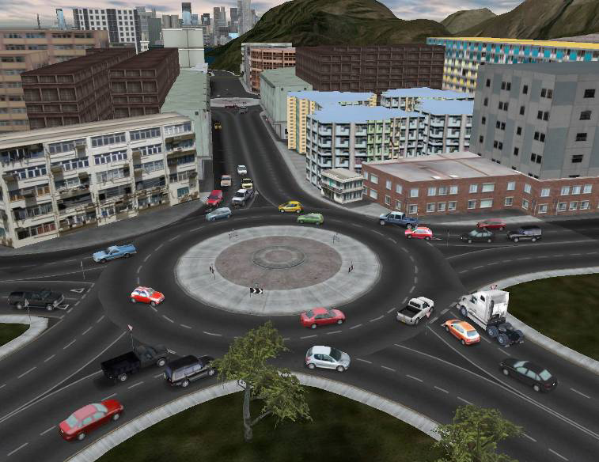
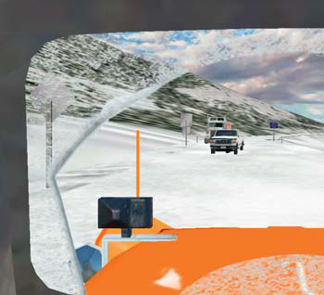
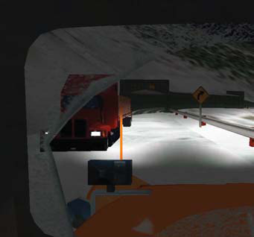
Snow Plow Simulator-Enhanced Training Program
Daytime Snow Plow Training from the Driver’s Perspective
Nighttime Snow Plow Training from the Driver’s Perspective

Slide 10
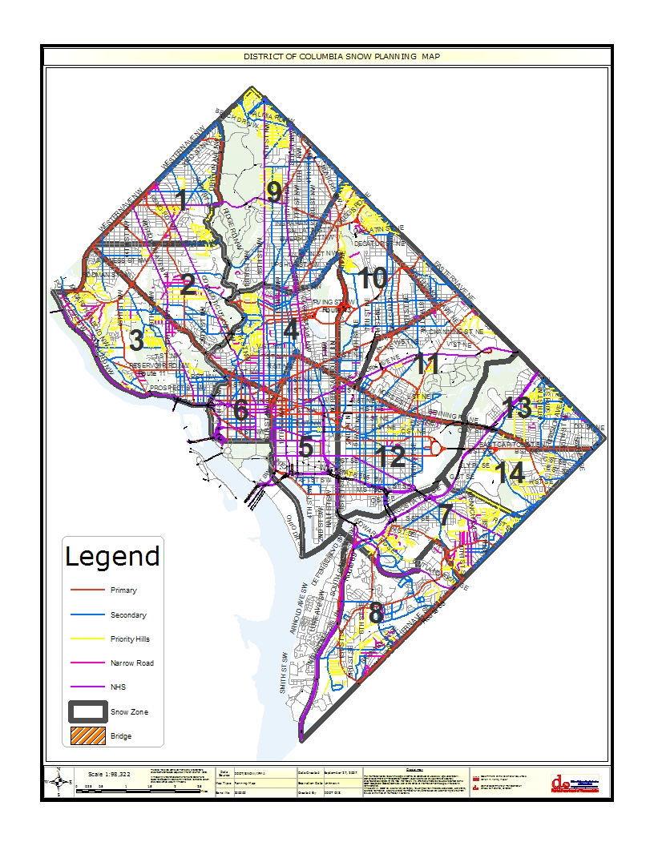
District Snow Zone Map

Slide 11
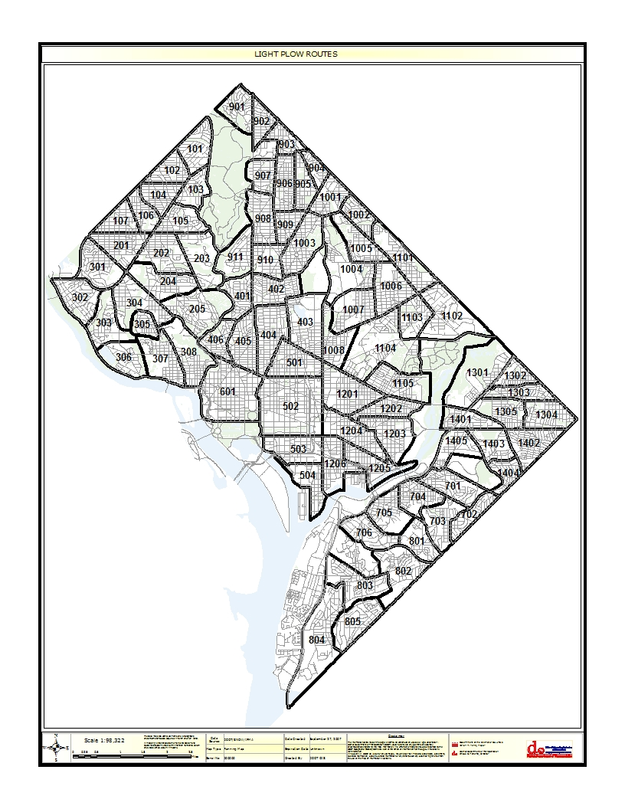
District Light Plow Routes

Slide 12
District Light Plow Route 703

Slide 13
Three Primary Mobilization Types
FULL DEPLOYMENT-(Snowfall ½”-6”)106 heavy plows, 82 light plows, 40 NHS plows, no contract plows
Above 6”: w/Contract Plows-Additional 75 heavy plows + 10 additional NHS heavy plows; possible use of 50 pieces of specialized equipment, e.g., Bobcats, if conditions warrant
PARTIAL DEPLOYMENT-(Dusting) 51 heavy plows, 41 light plows, 15 NHS heavy plows
PROWL DEPLOYMENT-(Bridges, overpasses) 25-30 heavy plows

Slide 14
DC Snow Fleet
TOTAL SNOW PROGRAM 2014-2015
Vehicle Type | Fleet Size
Municipal Heavy Plows (6w & 10w) | 137
Light Plows, Pick-Ups | 99
Liquid Dispensing Trucks | 8
Front End Loaders/Bobcats/Backhoes (load salt) | 30
NHS System-75 miles-Heavy Plows | 55
Sub-Total | 329
CONTRACTOR TRUCKS: Additional Contingency Equipment
NHS-Capital Paving, Hertz, Additional Equipment, e.g., Hauling Trucks/Loaders/Roll-Offs | 115
Horton Barber-25 Bobcats/25Backhoes | 50
Contract Plow Heavy Trucks (6w & 10w) | 50
Grand Total | 544

Slide 15
Snow Performance Measures – Penguin Chart
Major Streets
Residential Streets
Percent of
Percent of
Time from
streets
Time from
streets
Storm Type
Accumulation
storm’s end
passable
storm’s end
passable
Freezing Rain
Coating
12 hours
85%
12 hours
85%
Snow
0 to 2 inches
4 hours
85%
8 hours
85%
2 to 4 inches
6 hours
85%
12 hours
85%
4 to 8 inches
12 hours
85%
24 hours
85%
8 to 12 inches
18 hours
85%
36 hours
85%
12 to 18 inches
36 hours
75%
48 hours
75%
over 18 inches
36 hours
75%
60 hours
75%

Slide 16
Operations During a Storm
Tracking progress is conducted using several methods:
Zone Captain field reporting to Shift Commander and
Snow Command
AVL Progress Map on plowed/salted roadways
DC traffic cameras
Roadway Weather Information Stations (RWIS) Pavement Conditions-wet, dry, ice warnings

Slide 17
Operational Technology
Storm Trak Application-Tracks costs of snow events and other year-round emergencies, on-going training for administrative personnel
Snow AVL System-Tracks assets during snow events-new modems and salt/plow sensors in Snow Fleet
Continue testing in-cab display with real time progress maps for drivers
New in-field tablets for Zone Captains-Greater situational awareness and having real time location of assets and activity (salt/plow)

Slide 18
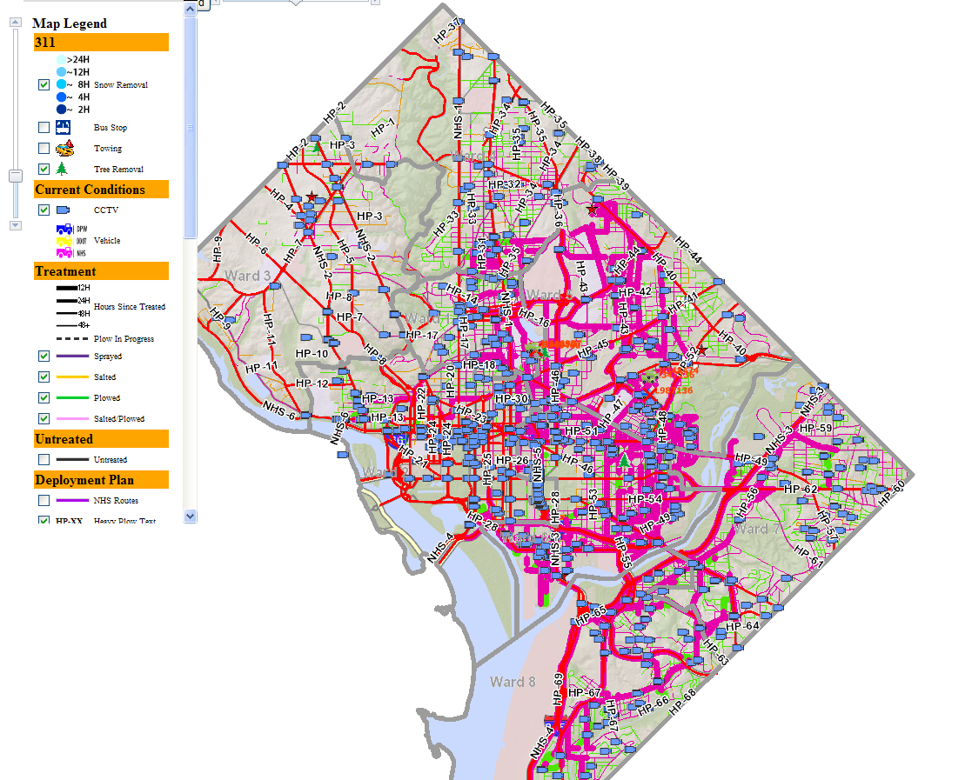
AVL-Operations
All Operations

Slide 19
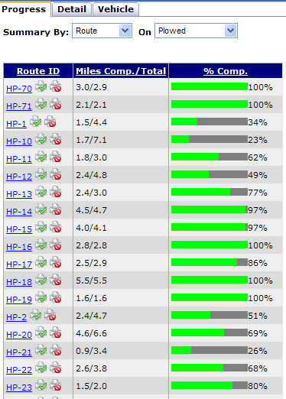
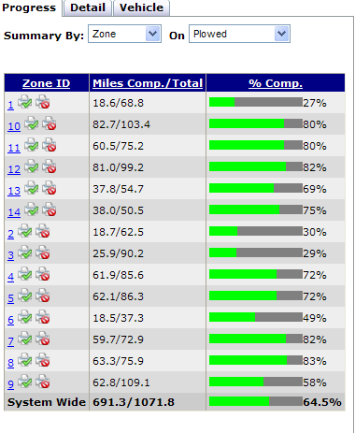
AVL Progress Report/ Completion Percentages
By Zone
By Route

Slide 20
Historical Weather Statistics
Average | Jan | Feb | Mar | Apr | May | Jun | Jul | Aug | Sep | Oct | Nov | Dec
Max (F) | 42.5 | 46.5 | 55.7 | 66.3 | 75.4 | 83.9 | 88.3 | 86.3 | 79.3 | 68.0 | 57.3 | 47.0
Min (F) | 27.3 | 29.7 | 37.3 | 45.9 | 55.8 | 65.0 | 70.1 | 68.6 | 61.8 | 49.6 | 40.0 | 32.0
Clear Days | 8 | 7 | 7 | 7 | 7 | 8 | 7 | 9 | 10 | 11 | 8 | 8
Rainy Days | 10 | 9 | 11 | 10 | 11 | 10 | 10 | 9 | 8 | 7 | 8 | 9
Precipitation | 3.21" | 2.63" | 3.60" | 2.77" | 3.82" | 3.13" | 3.66" | 3.44" | 3.79" | 3.22" | 3.03" | 3.05"
Snow | 6.2" | 6.3" | 1.6" | T | 0" | 0" | 0" | 0" | 0" | T | 1.0" | 3.1"
<32F Days | 22 | 18 | 9 | 1 | 0 | 0 | 0 | 0 | 0 | 0 | 4 | 16
RECORDS | 79 / -14 | 84 / -15 | 93 / 4 | 95 / 15 | 99 / 33 | 102 / 43 | 106 / 52 | 106 / 49 | 104 / 36 | 96 / 26 | 86 / 11 | 79 / -13

Slide 21
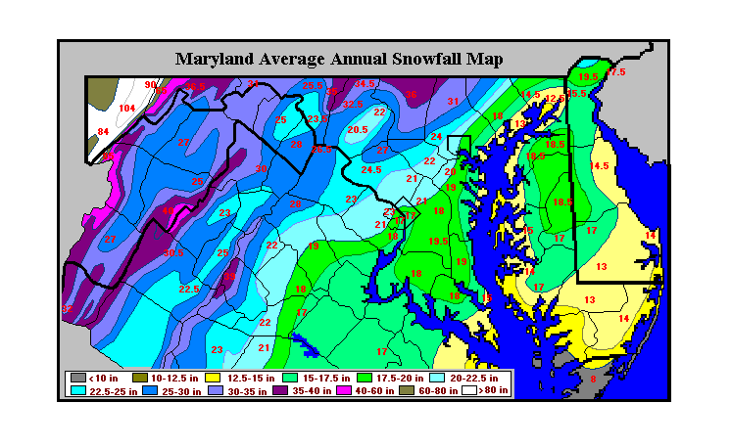
Average Snowfall in Region
DC

Slide 22
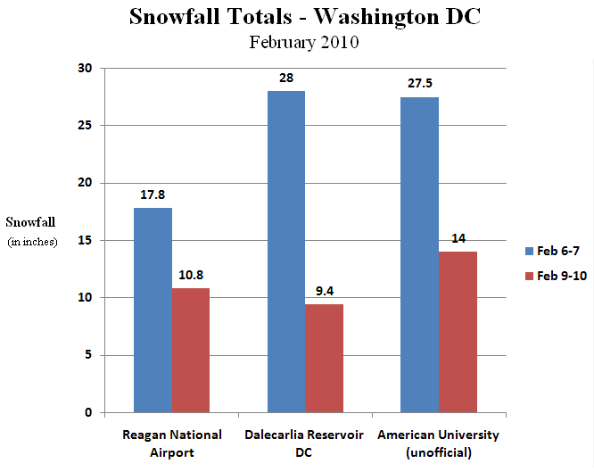
Snow Season 2009-2010
Note –
Reagan National understated the total for most of the District*
Totals in D.C. closer to 70 inches for 2009-2010
Among top 5 snowfalls recorded in Washington, DC
*Total of 56.4 inches for season is highest ever recorded in Washington, DC
Two storms back to back meant crews had no time to recharge
Snow totals in Northwest DC especially are much higher than totals recorded at Reagan National

Slide 23
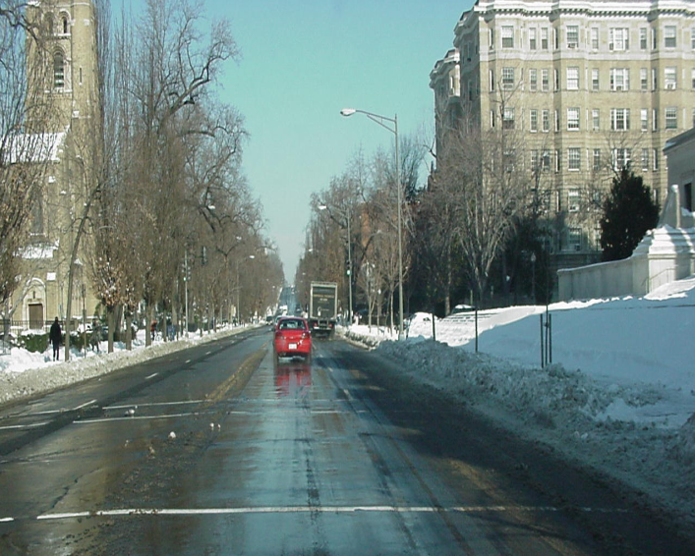
What Happened in 2013-2014
28 Deployments
9 Prowl
8 Partial
11 Full
32 inches of snow
55,000 tons of salt used
18th snowiest winter in DC
Low temperatures in single digits
National/regional salt shortages

Slide 24
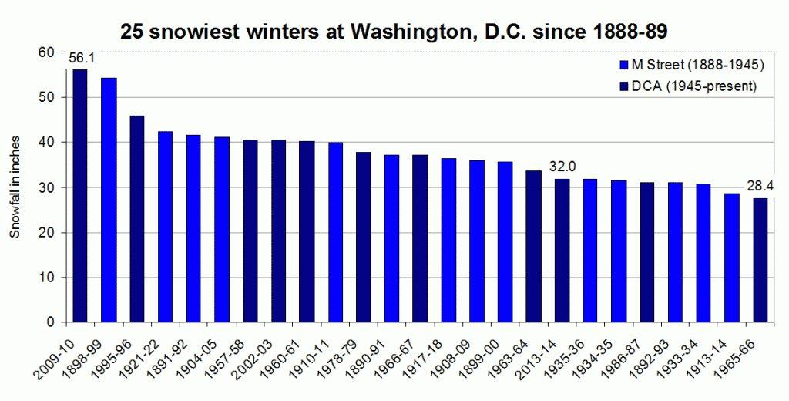
25 Snowiest Winters in DC- Last Winter 18th Snowiest

Slide 25
Snow Season Statistics
SNOW SEASON | 2003-2004 | 2004-2005 | 2005-2006 | 2006-2007 | 2007-2008 | 2008-2009 | 2009-2010 | 2010-2011 | 2011-2012 | 2012-2013 | 2013-2014
TOTAL Mobilizations | 4 | 12 | 7 | 13 | 13 | 13 | 20 | 16 | 11 | 20 | 28
Prowl Deployments |  | 6 | 5 |  | 4 | 1 | 4 | 6 | 7 | 4 | 9
Partial Deployments |  |  |  |  |  | 6 | 3 | 2 | 1 | 8 | 8
Full Deployments |  | 6 | 2 |  | 9 | 6 | 13 | 8 | 3 | 8 | 11
Annual Snowfall | 15 inches | 30 inches | 15 inches | 25 inches | 4.9 inches | 11.5 inches | 70 inches | 10 inches | 1.2 inches | 2.5 inches | 32 inches
Spending | $3.2M | $5.3M | $4.2 | $6.8 M | $6.5M | $6M | $25M | $6.2M | $6.2M | $6.2M | $12.5M

Slide 26
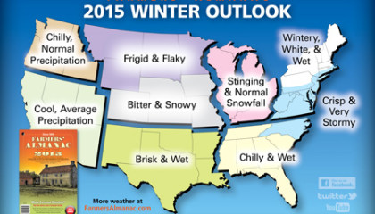
2014-2015 Winter Forecast

Slide 27
SIX-YEAR SALT USAGE
SNOW SEASON | TONS OF SALT USED | EVENTS | INCHES OF SNOW- ICE
2005-2006* | 12,000* | 7 | 8.8
2006-2007 | 23,074 | 13 | 9.1
2007-2008 | 20,791 | 14 | 4.9
2008-2009 | 26,599 | 13 | 11.5
2009-2010* | 79,674* | 20 | 70
2010-2011 | 31,143 | 16 | 10
2011-2012* | 7,372* | 11 | 1.2
2012-2013 | 18,616 | 20 | 2.5
2013-2014 | 55,000 | 28 | 32
*6 -Year Average=26,746 Tons Per Season

Slide 28
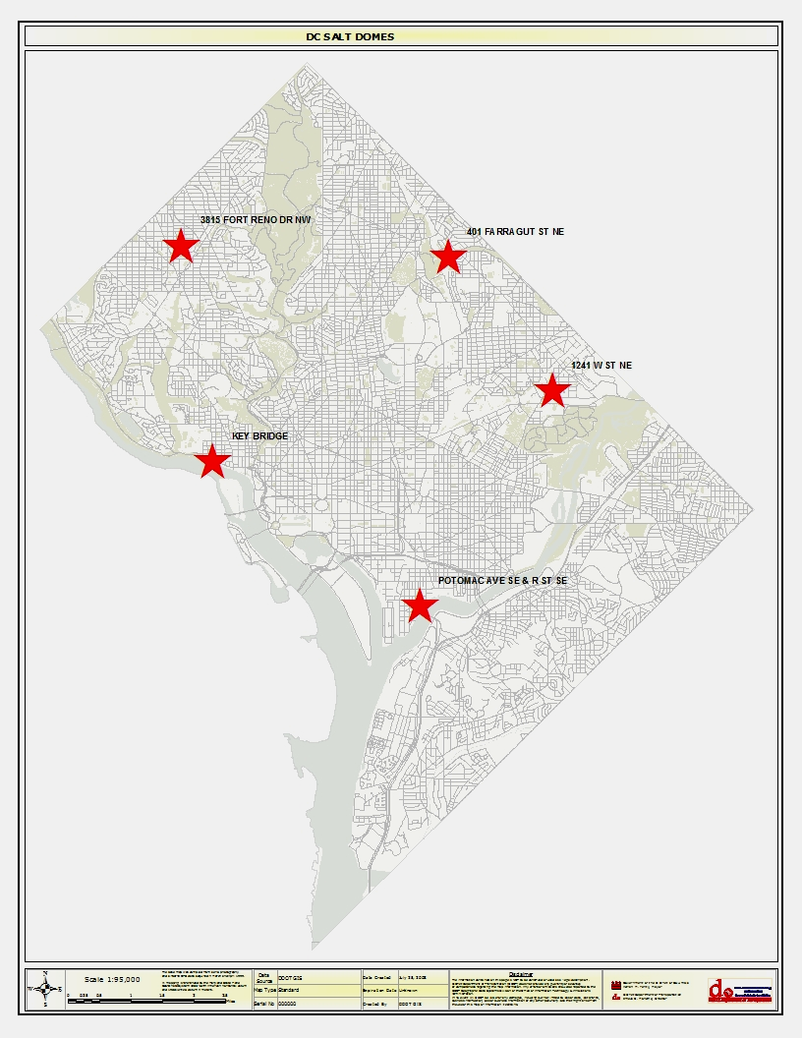
Materials/Salt Domes
TOTAL:
39K Capacity
32.8K Inventory
Farragut =18K Cap./16.5K Inv.
W Street = 12K Cap./7.5K Inv.
Ft.Reno=4.5K Cap./4.3K Inv.
Potomac & R= 4.5K Cap./4.5K Inv.
K Street/Key Bridge= 100 Tons Cap. /100 Tons Inv.
60,000 gallons of brine and beet juice for pre-treating roadways
Potomac dome to be demolished for soccer stadium

Slide 29
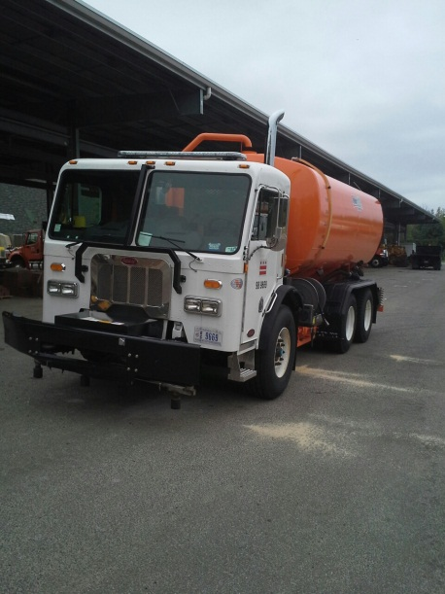
Salt Brine Application Priorities/Estimates
Major DC Bridges/National Highway System- Capital Paving- 14,000 gal.; 5 Trucks; 16-24 hours (246 miles)
1 pass each direction
District Red and Blue Routes- 33,000 gal.; 7 trucks; 16-24 hours (552 miles) 1 pass each direction
District Residential Yellow Routes (Hills)- 5,000 gal.; 3 trucks; 12 hours (123 miles) 1 pass each direction

Slide 30
Expand Pre-Treatment/ Anti-Icing
DPW/DDOT crews apply liquid salt brine with beet juice on critical bridges and roadways 1 or 2 days in advance of frozen precipitation
Provides a proactive strategy to prevent freeze-ups
Reduces opportunity for unexpected early precipitation to freeze instantly on surface
Expanded brine application
Conserve salt usage

Slide 31
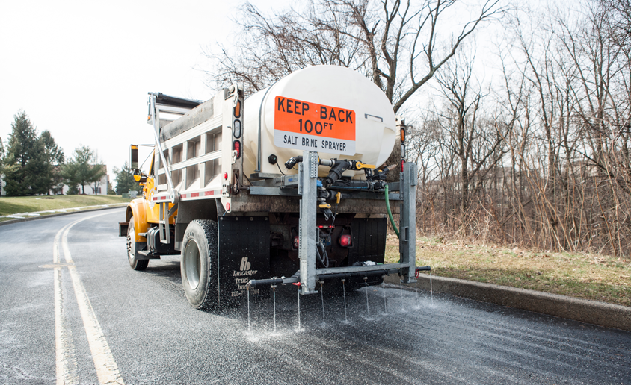
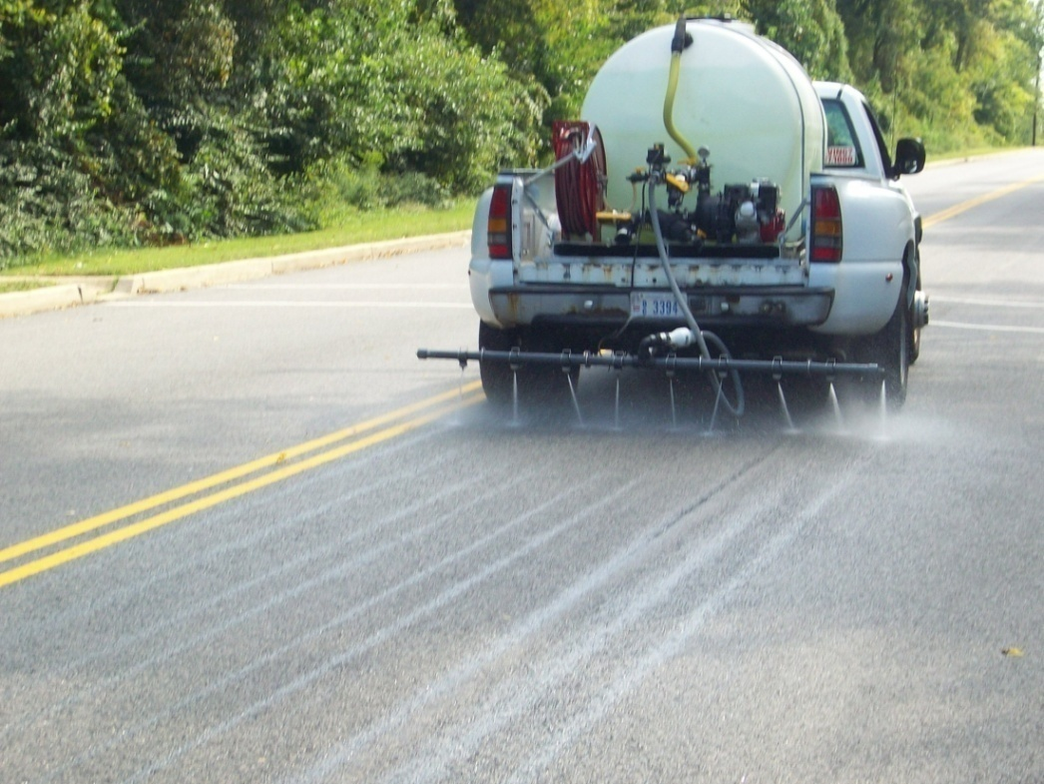
Typical Liquid Spray Units

Slide 32
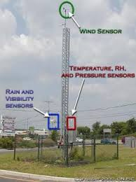
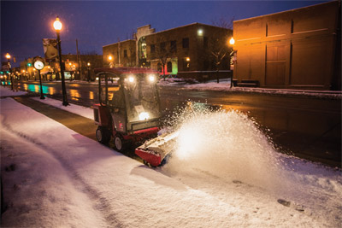
Improvements for 2014-2015
New brine production system-Increased production, more efficient loading
New specialized sidewalk equipment to clear bridge sidewalks
2 additional RWIS stations (11th Street Bridge) to monitor air/pavement temps in DC; 11 RWIS stations total
Expand pilot AVL in-cab screens to assist drivers in neighborhood streets
Expanding use of new ceramic/rubber snow plow blades
Pet safe deicer for bridge sidewalks

Slide 33
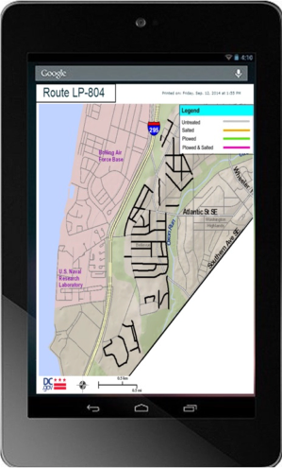
In-vehicle AVL Screen to Show
Route Progress/Pilot Sidewalk Clearing Equipment

Slide 34
Lessons Learned/Contingency Plans for Major Events
28 Additional snow plows and spreaders
Specialized Equipment Contract – 25 Bobcats and 25 backhoes-Placeholder/Funding
Expanded NHS Contract (Capitol Paving) – 15 heavy plows, 15 loaders, 25 roll-off trucks, 50 hauling trucks
2 Salt Contracts – Tricon, COG Salt Contract
Expanded BPA for Contract Plow Equipment and Trucks – Bobcats, loaders, backhoes

Slide 35
Improved Regional/COG Cooperation
Improved Regional Operational Coordination
Strengthened coordination/deployment with MPD on outages at major signalized intersections and evacuation routes
Metropolitan Area Transportation Operations Coordination (MATOC) expansion-RITIS (Regional Integrated Transportation Information System) program in Snow Room-TMCs
Improved WMATA communications- Metrobuses’ ability to travel in snow
Coordination with PEPCO on response and restoration

Slide 36
Improve Real Time Information
Improve Real Time Information/Situational Awareness
Strengthened protocols, coordination among regional snow commands during events-Communication
Expanded use of MATOC in snow command, road closures, regional TMC communications maintained in snow ops
Real Time Media/Public Outreach
Establish media hub that releases coordinated messages to public on storms
Scripts established for either release or stay in place
Improve public outreach on traffic delays/closures and incidents affecting major roadways
Remind property owners of sidewalk shoveling responsibilities

Slide 37
Concerns/Logistical Challenges
Capital funding to design/build replacement for Potomac and R salt dome
Additional snow program funding: salt increase
Snow dump locations in the District: RFK; working with DGS to identify additional satellite locations

Slide 38
Thank You
QUESTIONS

